Slide 1
lab1-Data Lab

Slide 2
1 Introduction
2 The Puzzles
2.1 Bit Manipulations
2.2 Two’s Complement Arithmetic
2.3 Floating-Point Operations
3 Evaluation

Slide 3
Introduction
The purpose of this assignment is to become more familiar with bit-level representations of integers and floating point numbers. You’ll do this by solving a series of programming “puzzles.”
Many of these puzzles are quite artificial, but you’ll find yourself thinking much more about bits in working your way through them.

Slide 4
The Puzzles
Some tips below:
bits.c is the file you will be working on
Read the instructions carefully – both in the bits.c file header and the lab writeup
You are expected to write C which follows ANSI C standards
Try and finish all puzzles before you set out to optimize your solution

Slide 5
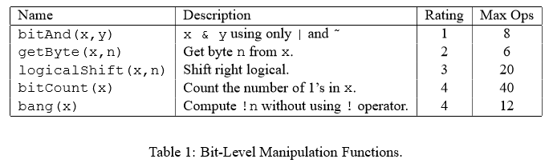
The Puzzles(Bit Manipulations)

Slide 6
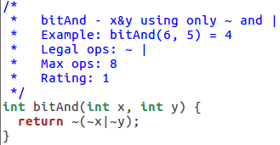
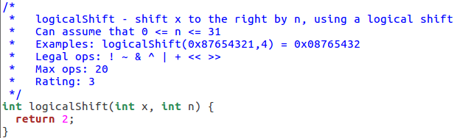
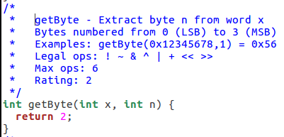
The Puzzles (Bit Manipulation)
1、bitAnd(x,y) 3、logicalShift(x,n)
2、getByte(x,n)

Slide 7
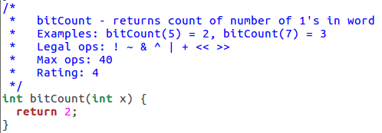
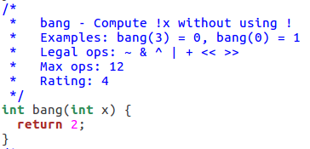
The Puzzles (Bit Manipulation)
4、Bitcount(x)
5、bang(x)

Slide 8
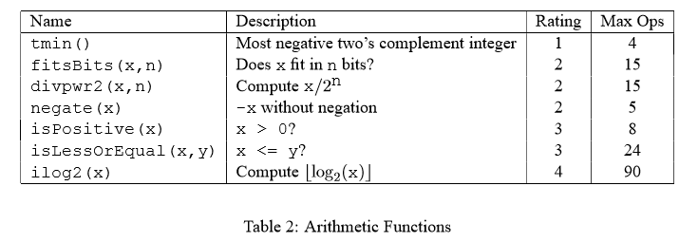
The Puzzles(Two’s Complement Arithmetic)

Slide 9
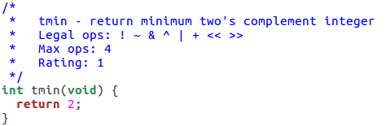
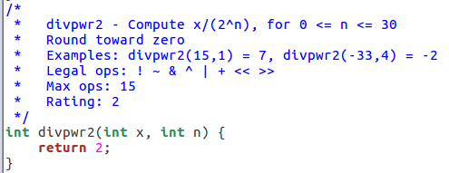
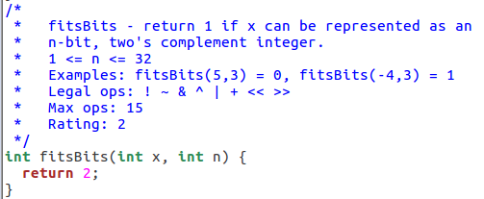
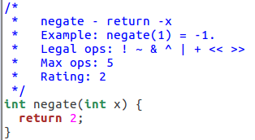
The Puzzles(Two’s Complement Arithmetic)
6、tmin() 8、divpwr2(x,n)
7、fitsBits(x,n)
9、negate(x)

Slide 10
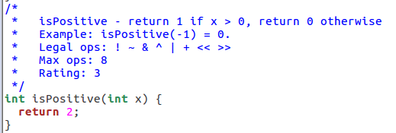
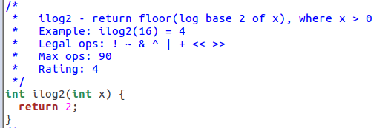
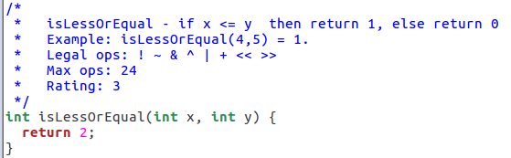
The Puzzles(Two’s Complement Arithmetic)
10、isPositive(x) 12、iLog2(x)
11、isLessOrEqual(x,y)

Slide 11
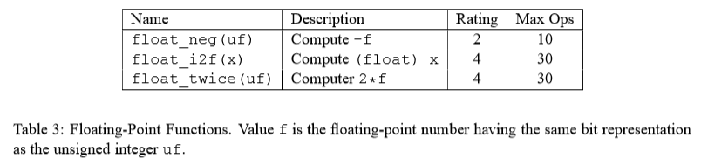
The Puzzles(Floating-Point operations)

Slide 12
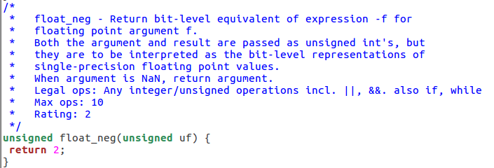
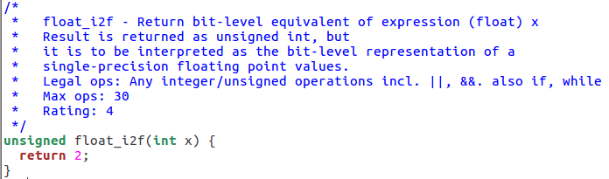
The Puzzles(Floating-Point operations)
13、float_neg(uf)
14、float_i2f(x)

Slide 13
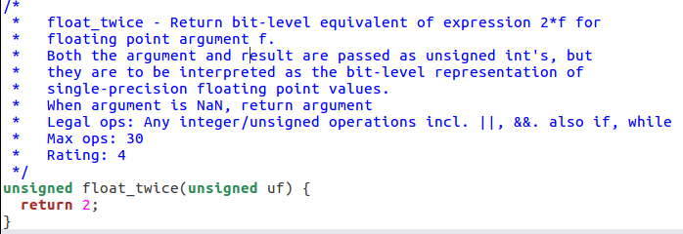
The Puzzles(Floating-Point operations)
15、float_twice(unsigned uf)

Slide 14
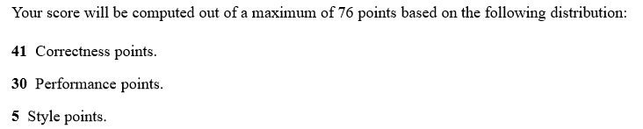
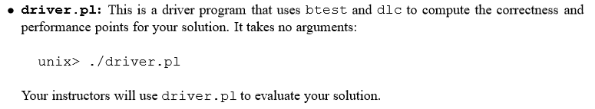
Evaluation

Slide 15
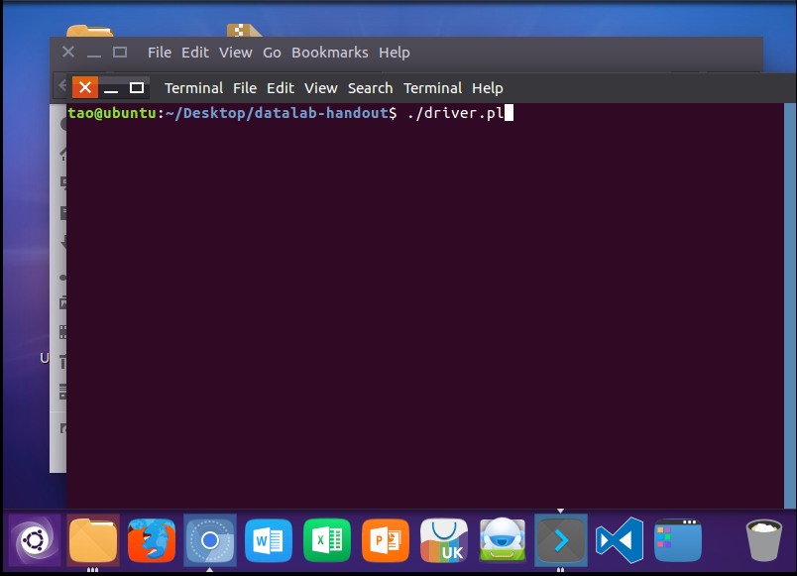
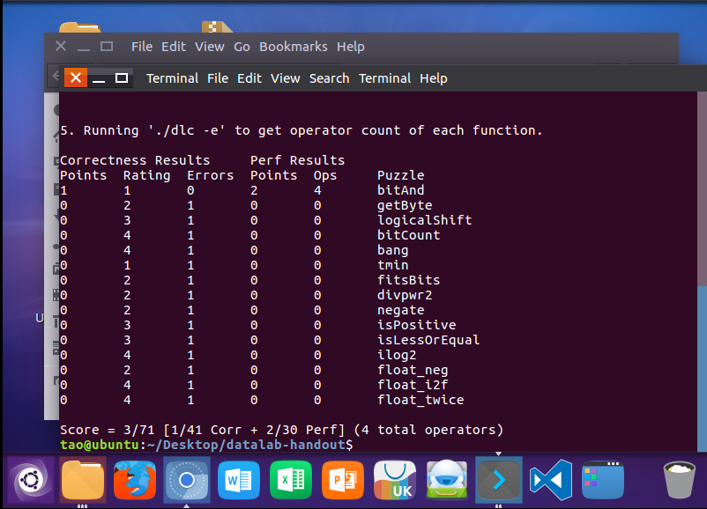
Evaluation

